Slide 1
GLAMIFY

Slide 2
AGENDA
Company Overview
About Me
Project Definition​
Area Of Focus
Project Platforms
​Technologies
Diagrams
UI
Code
MyWork TimeLine

Slide 3

SAUBHAGYAM

Slide 4
COMPANY OVERVIEW
SAUBHAGYAM Web Pvt. Ltd. Is An innovative Leading Web Development, mobile Application Development, And Services Providing based Company.
That Has The Specialization And expertise In Web Development For various Types Like Shopify development, Ecommerce Web development, And Many More.
There Are two Branch INDIA And US

Slide 5
ABOUT ME
Name | Naman Prakashbhai Doshi
Joining_date | 04-01-2024
Designation | Python Intern
Mobile_no | 9624185617
Email | namandoshi459@gmail.com
Industry_Mentor | Prashant Shastri
Designation | Team leader
Contec | prashant@saubhagyam.org

Slide 6
PROJECT DEFINATIONS
Glamify Is A State-of-the-art E-commerce Platform Designed To Revolutionize The Beauty And Wellness Shopping Experience.
As A Comprehensive Web Application, Ios App, And Android App Project.
Glamify Focuses On Curating A Diverse And High-quality Selection Of Beauty Products.
Glamify Offers Users A Seamless And Intuitive Interface To Explore And Purchase Skincare, Cosmetic, And Wellness Essentials. ​

Slide 7
AREAS OF FOCUS
PERSONALIZED BEAUTY SOLUTIONS FOR B2B PARTNERSHIP
Explore opportunities to collaborate with beauty salons, spas, and wellness centers by offering personalized beauty solutions through Glamify.
Provide a B2B platform where these businesses can access a curated selection of beauty and skincare products to enhance their service offerings.

Slide 8


PLATFORMS
WEB APPLICATION
ANDROID APPLICATION
IOS APPLICATION
We create web applications for broad accessibility through browsers, enabling universal user reach and streamlined updates.
Android applications provide a dedicated, user-friendly platform, enhancing accessibility and user engagement on mobile devices.
IOS applications ensure a tailored user experience on Apple devices, capitalizing on the platform's security and performance, enhancing brand visibility and user engagement.

Slide 9
TECHNOLOGIES
FRONT-END
BACK-END
DATABASE
HARDWARE
SOFTWARE
REACTJS
PYTHON
DJANGO
POSTGRESQL
INTEL CORE I5
RAM 8GB
HARD DISK: 1TB
VS CODE
PGADMIN4
ANDROID STUDIO
XCODE
VISUAL PARADIGM

Slide 10
ADMIN
Login
Manage stock
Manage product & categories
Manage packages
Manage discounts & offers
Manage orders
Manage payment
Manage cancel order
Manage sales return
Manage feedback & rating

Slide 11
CUSTOMER
Registration
Login
Manage profile
Search & View product & Package
View Offers & Discount
Add to cart
Place order
Make payment
Cancel order
Get Invoice
View & Give feedback and rating

Slide 12
ENTITY RELATIONSHIP

Slide 13
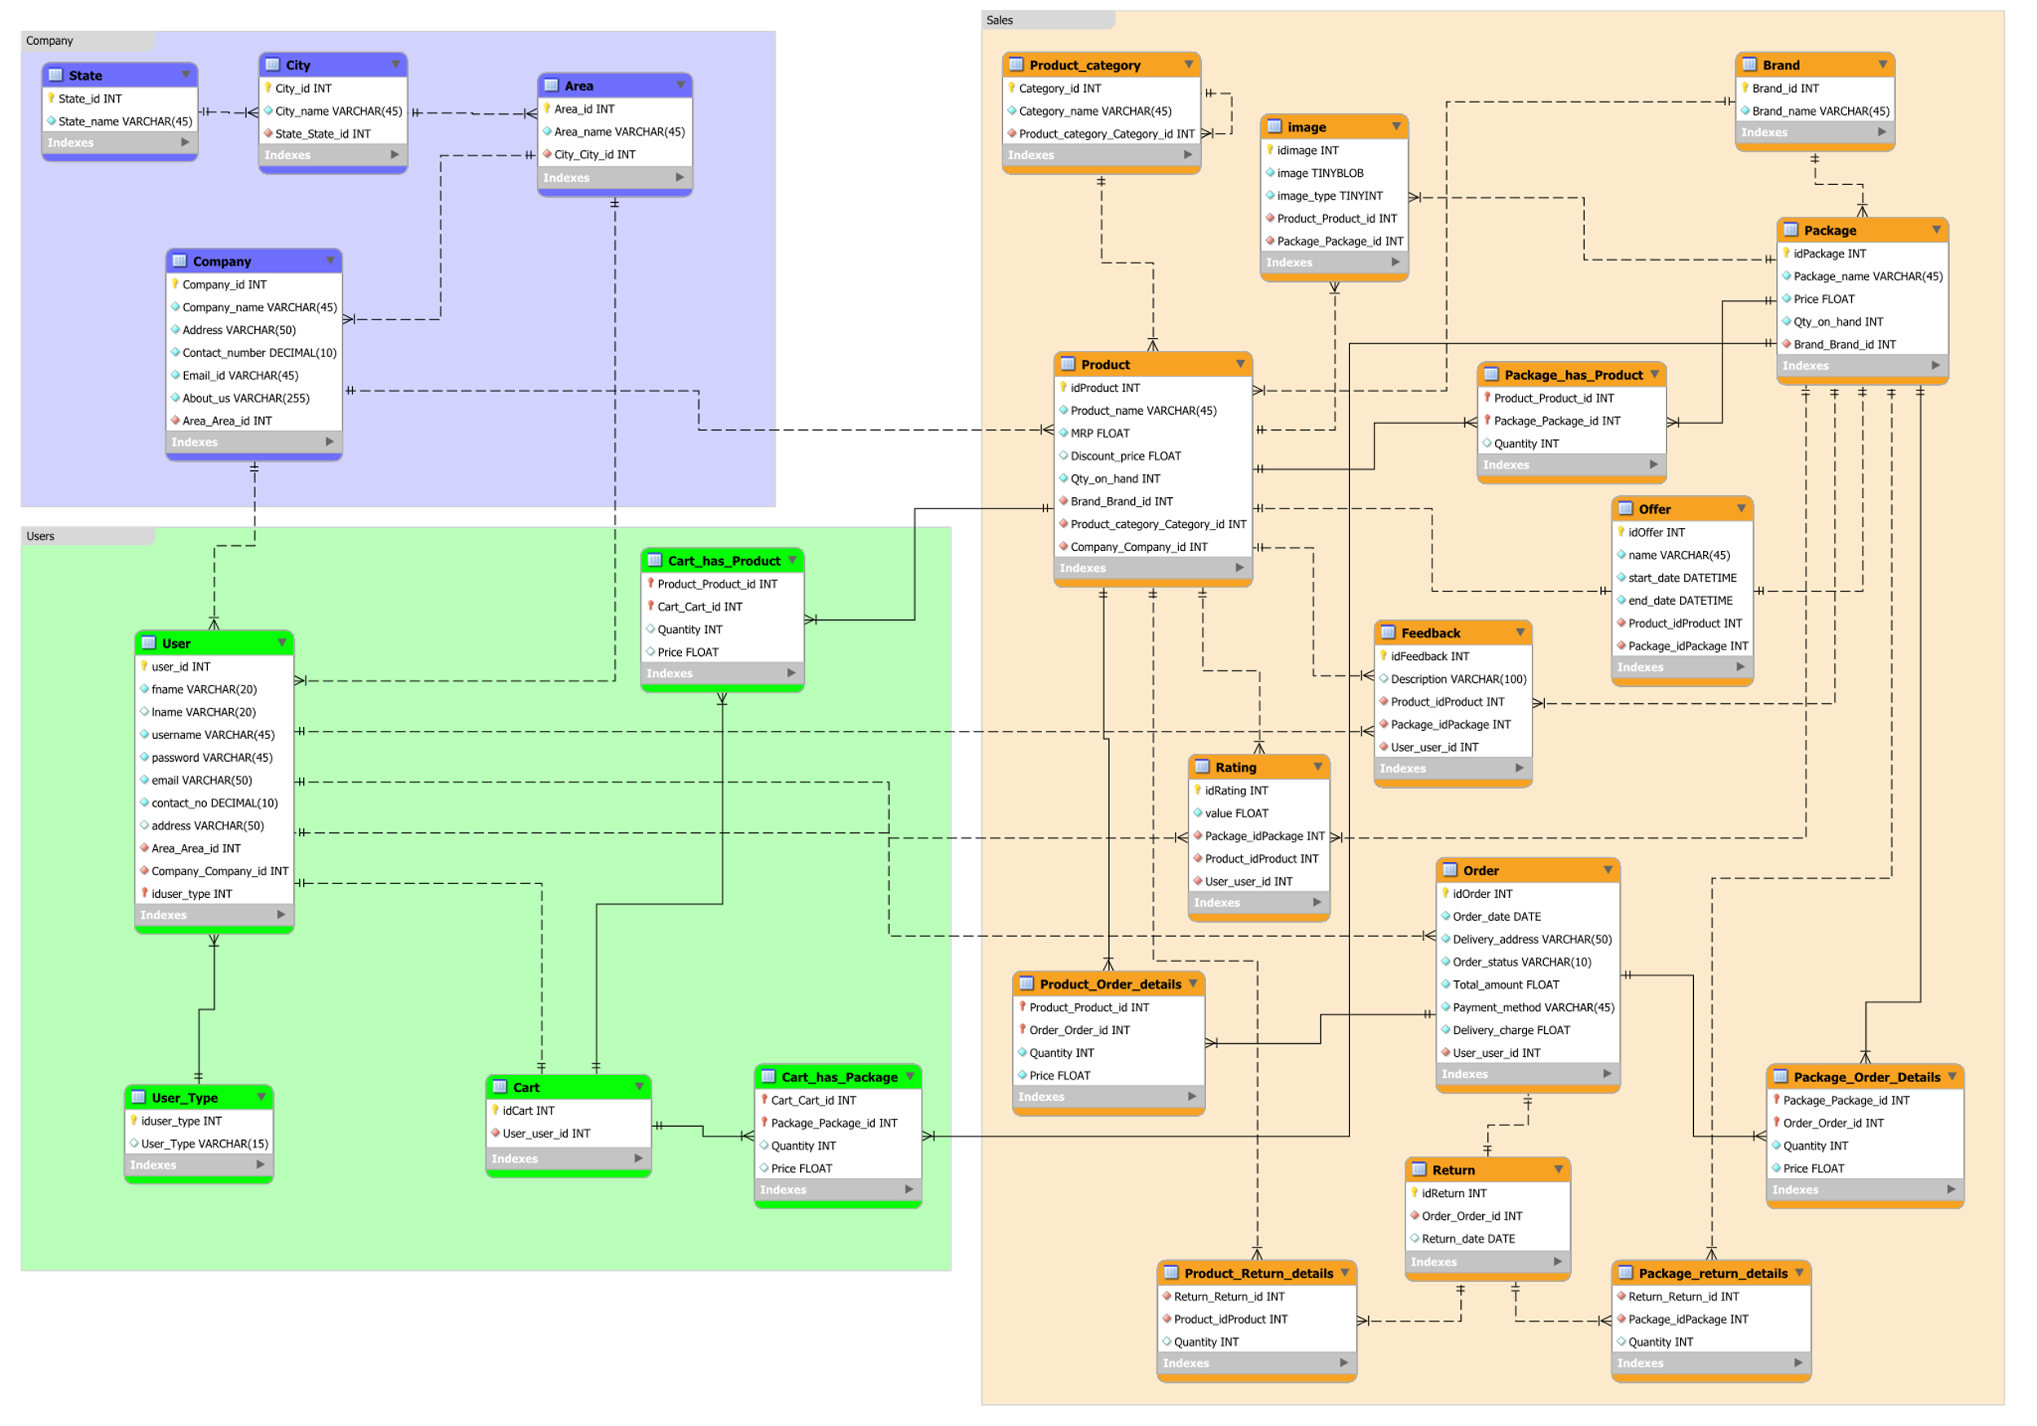
ER DIAGRAM

Slide 14
USE CASE

Slide 15
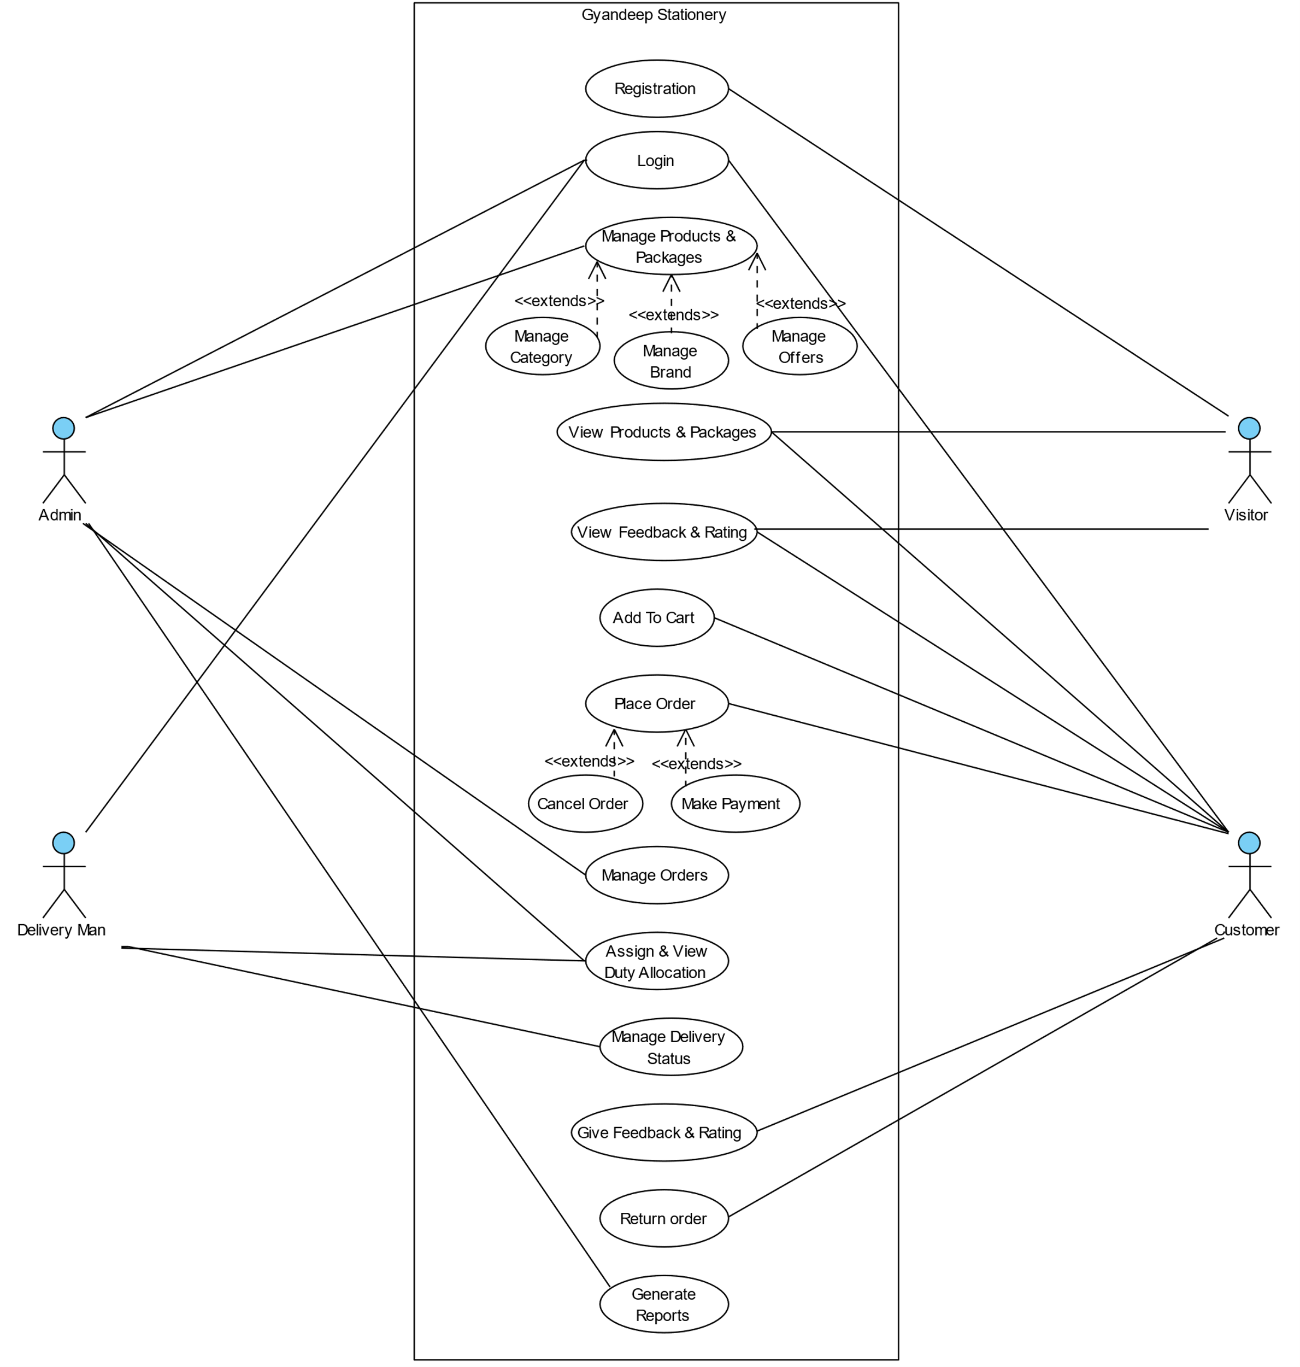
Use case

Slide 16
ACTIVITY

Slide 17
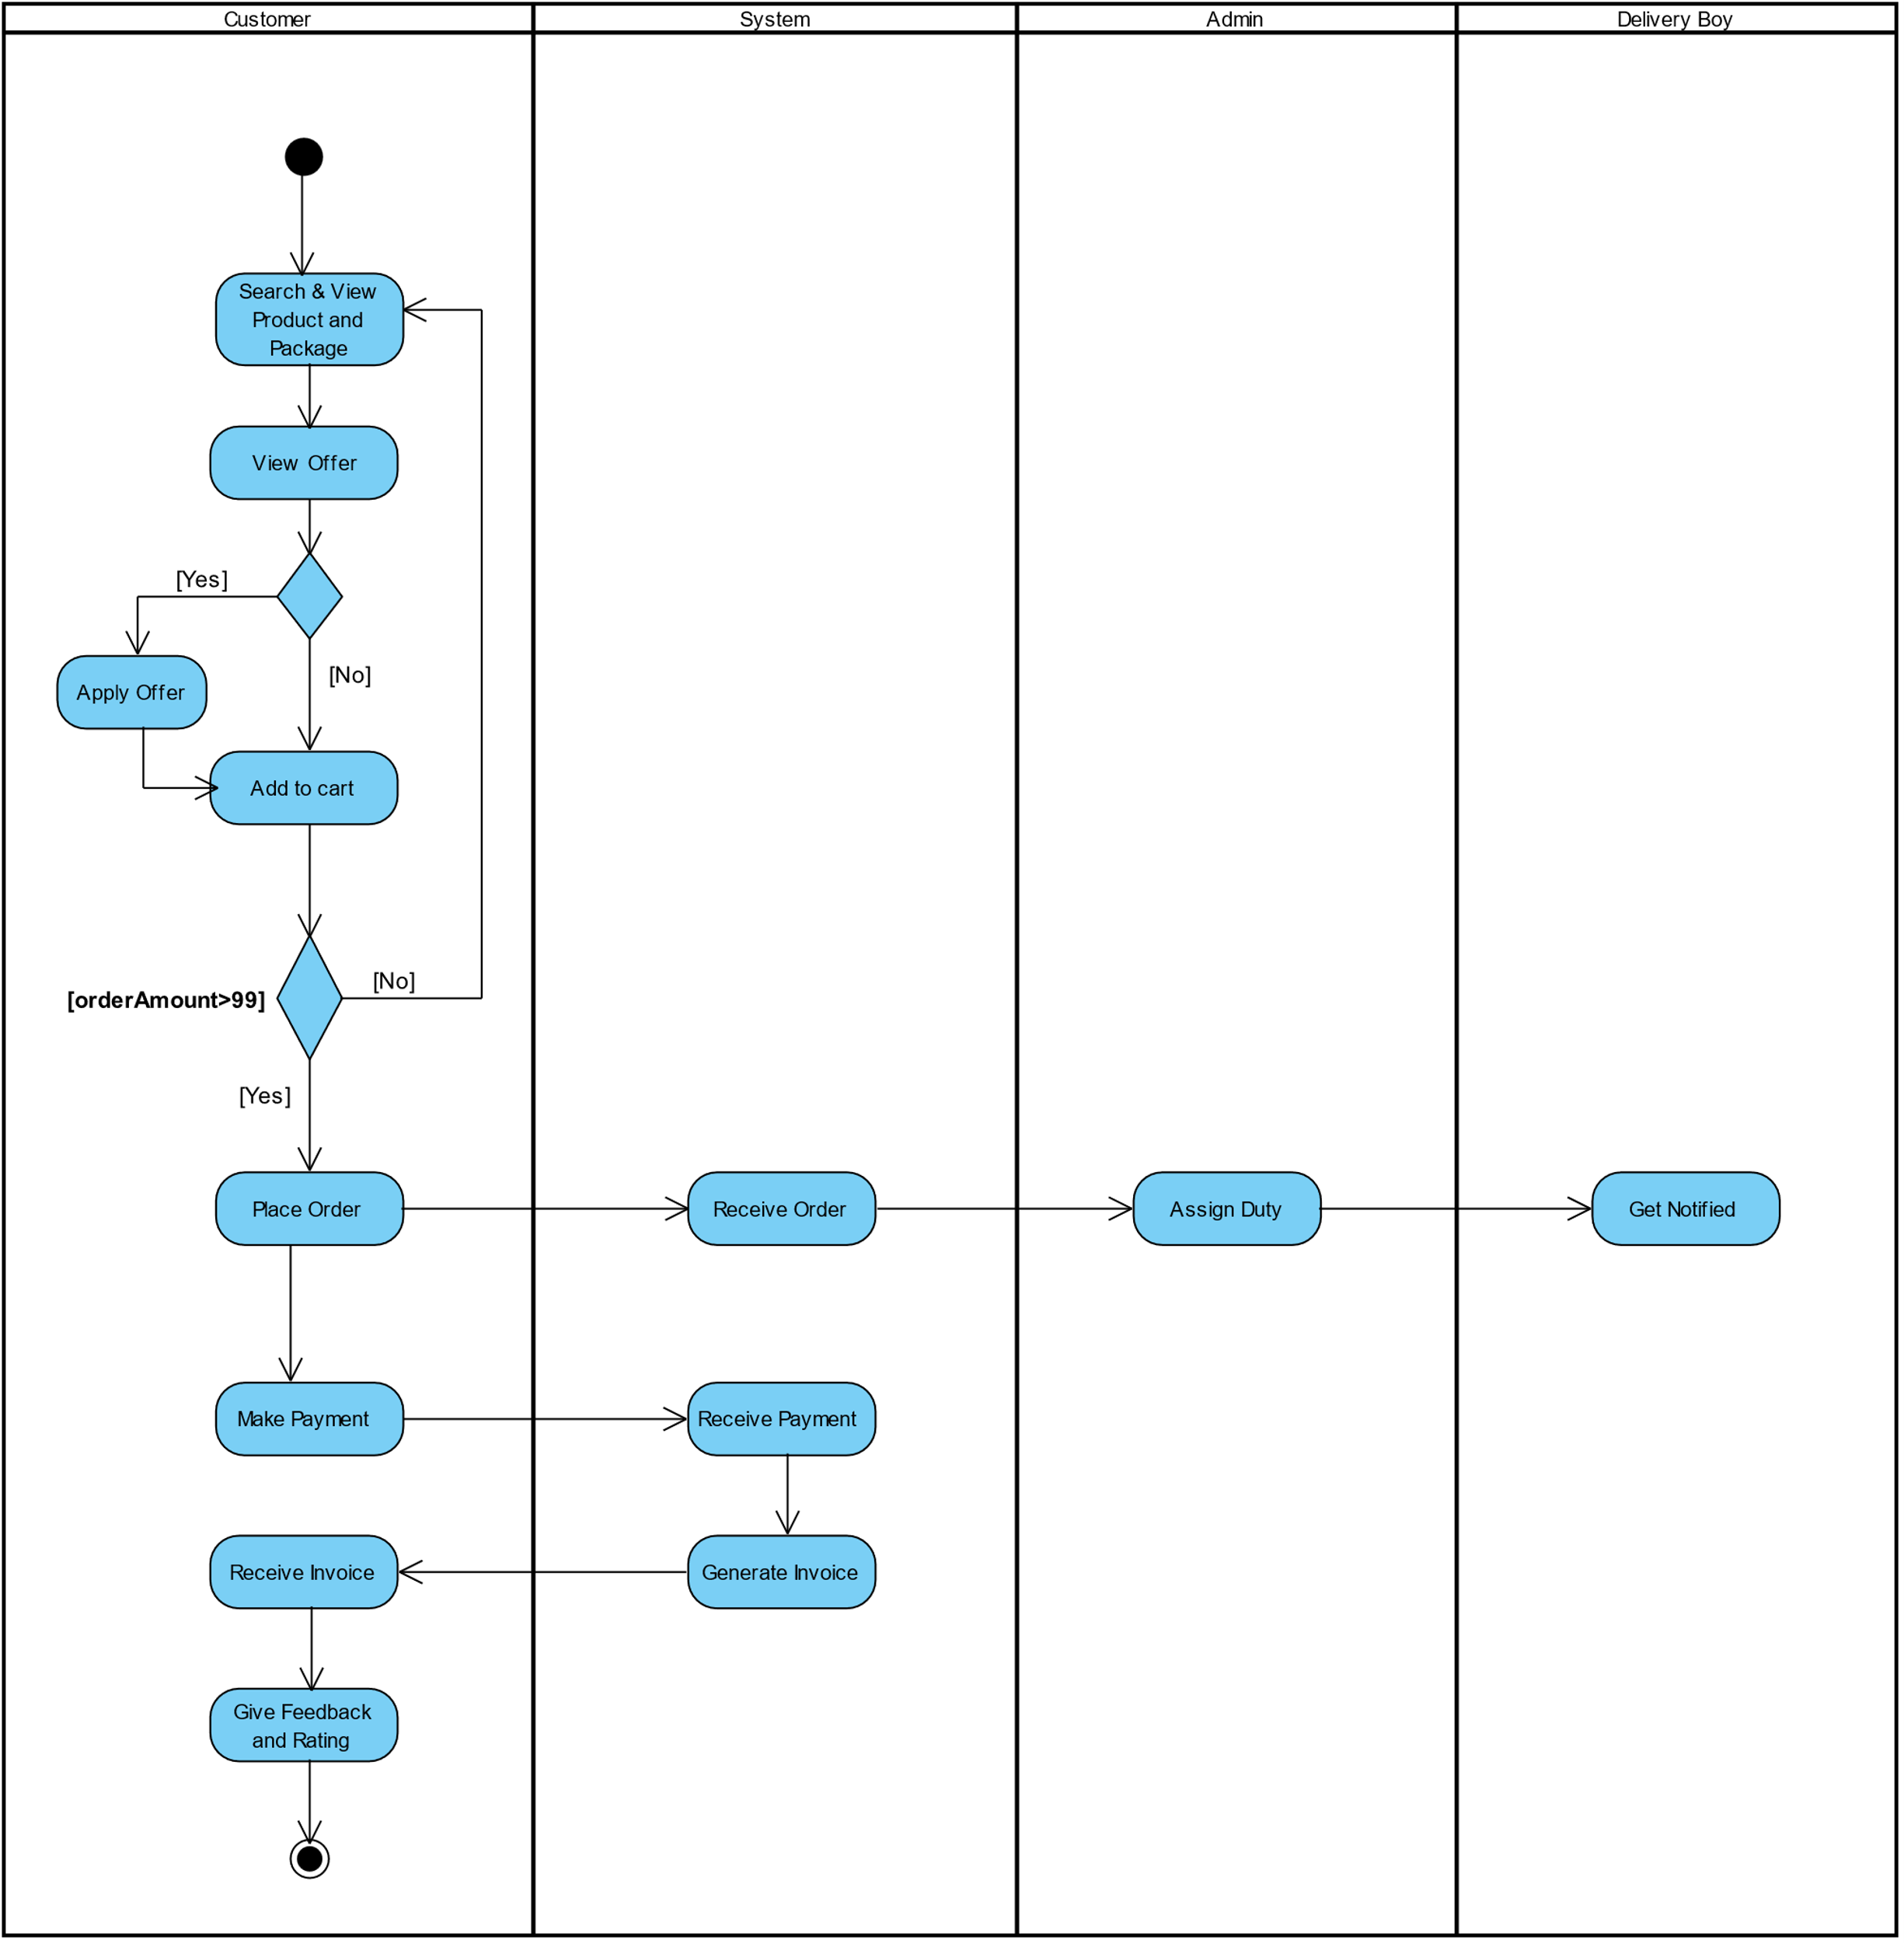

Slide 18
STATE CHART

Slide 19
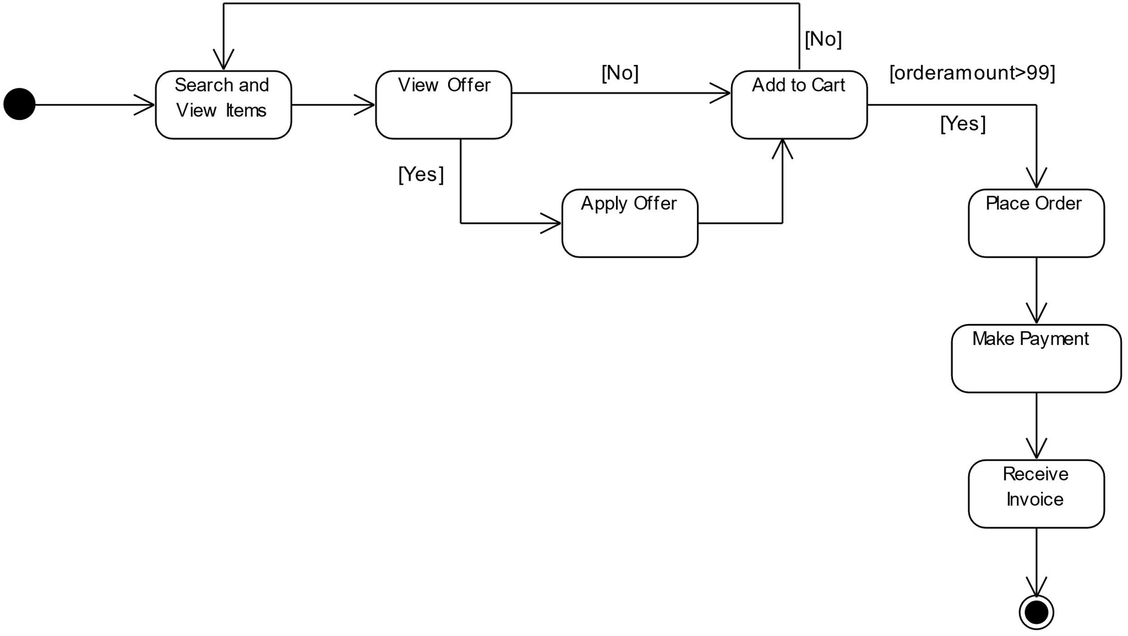

Slide 20
SEQUENCE

Slide 21
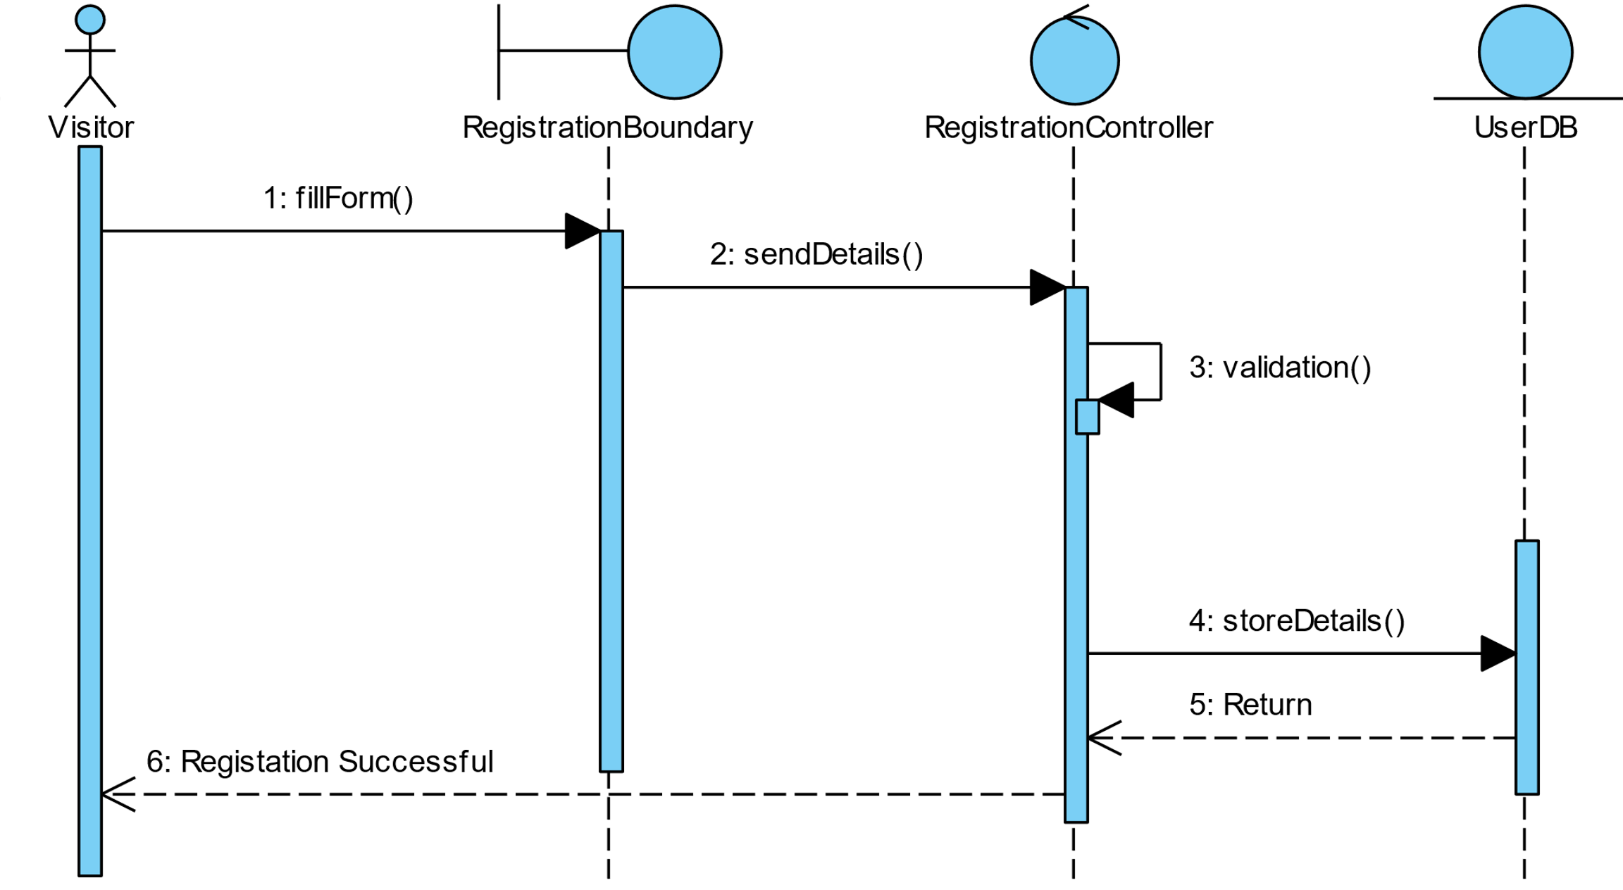
Registration

Slide 22
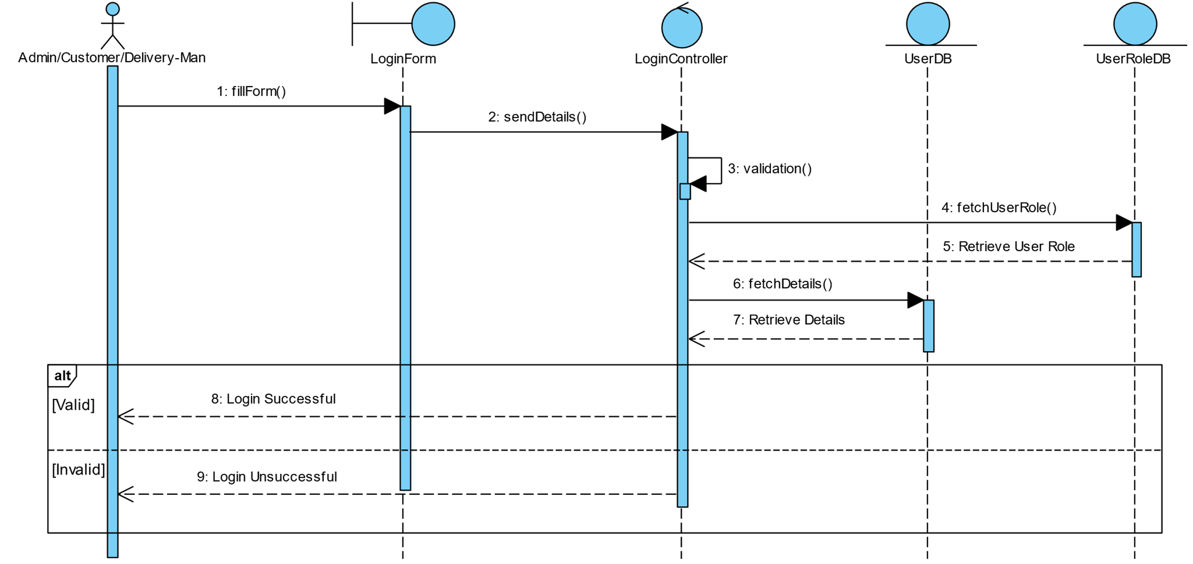
Login

Slide 23
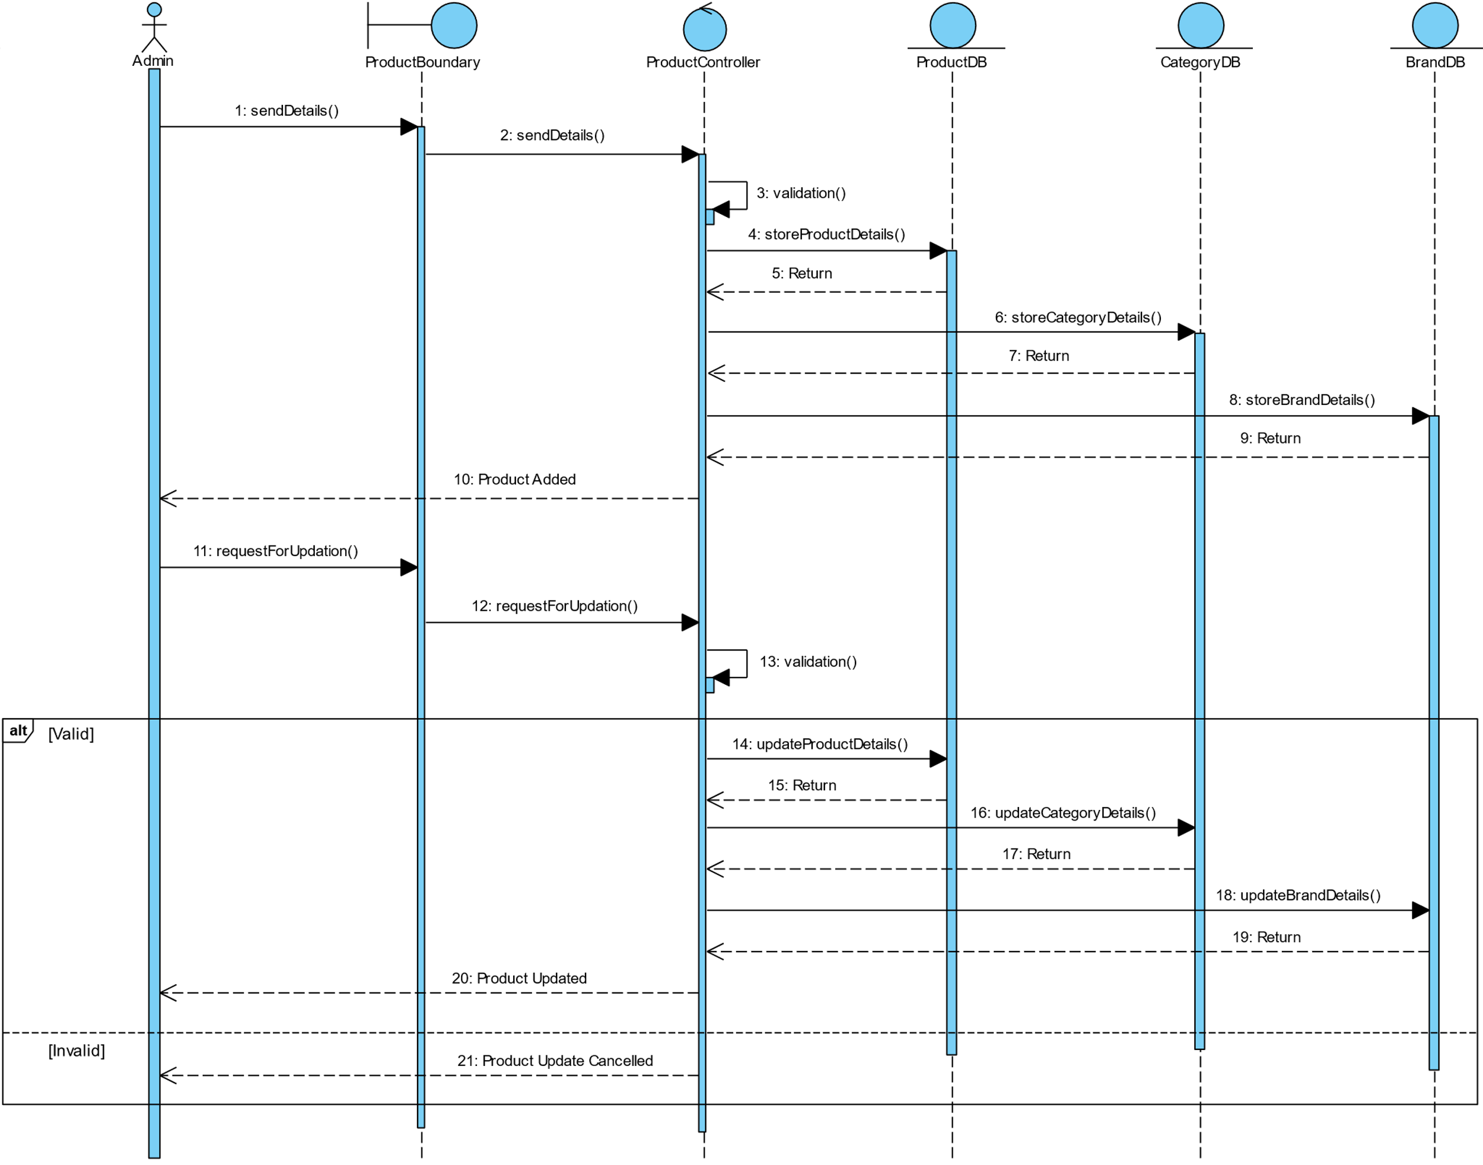
Diagrams
Manage Product

Slide 24
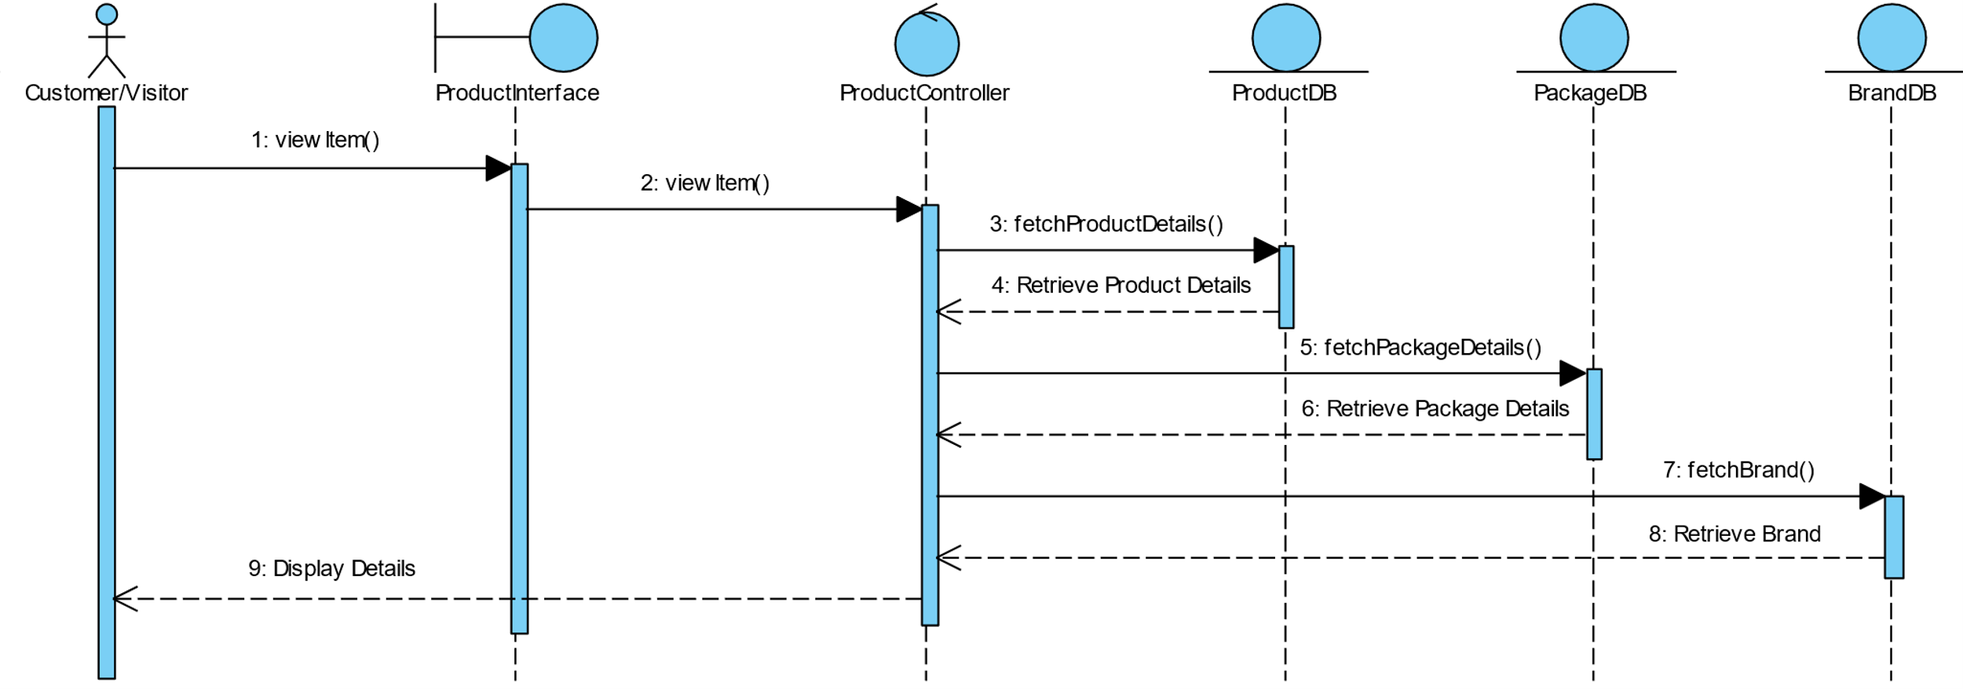
View Items

Slide 25
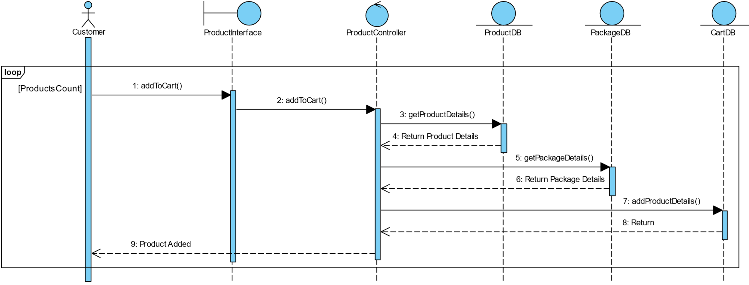
Add to cart

Slide 26
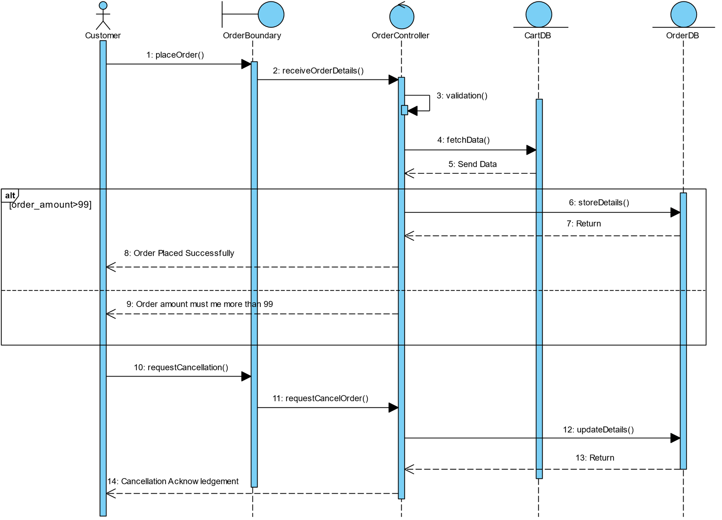
Diagrams
Place Order

Slide 27
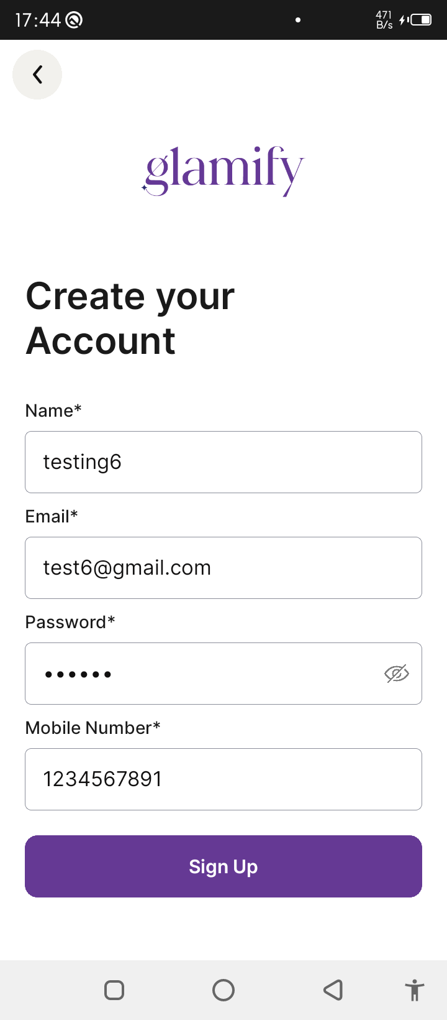
UI

Slide 28
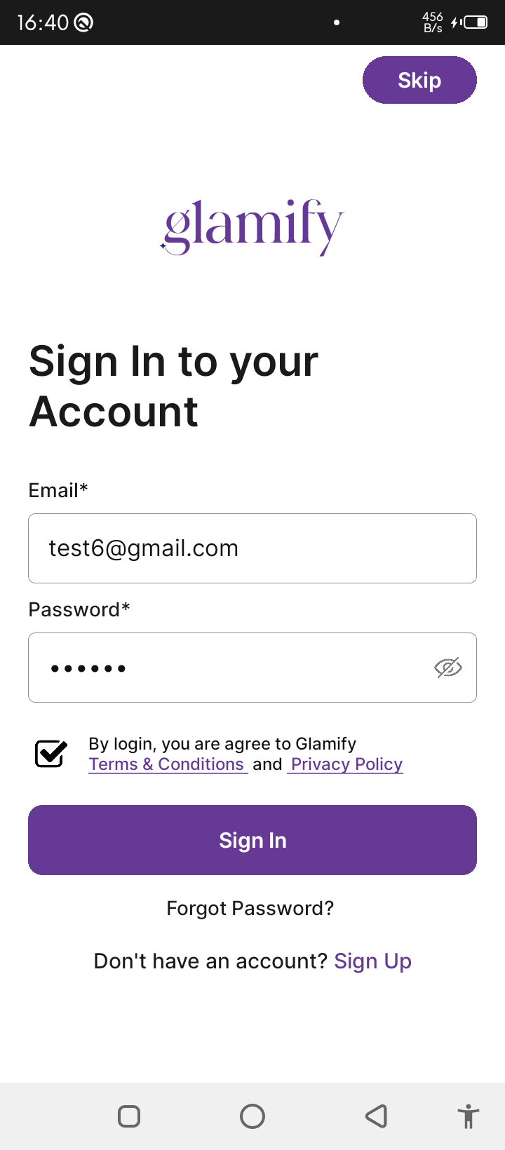
UI

Slide 29
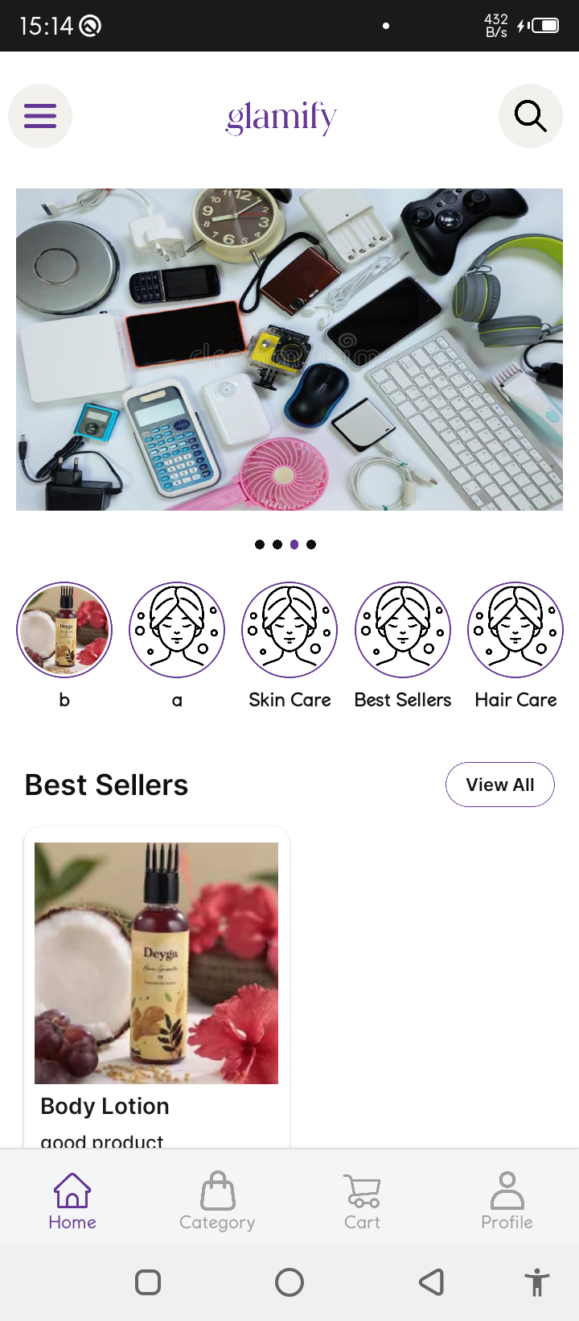
UI

Slide 30
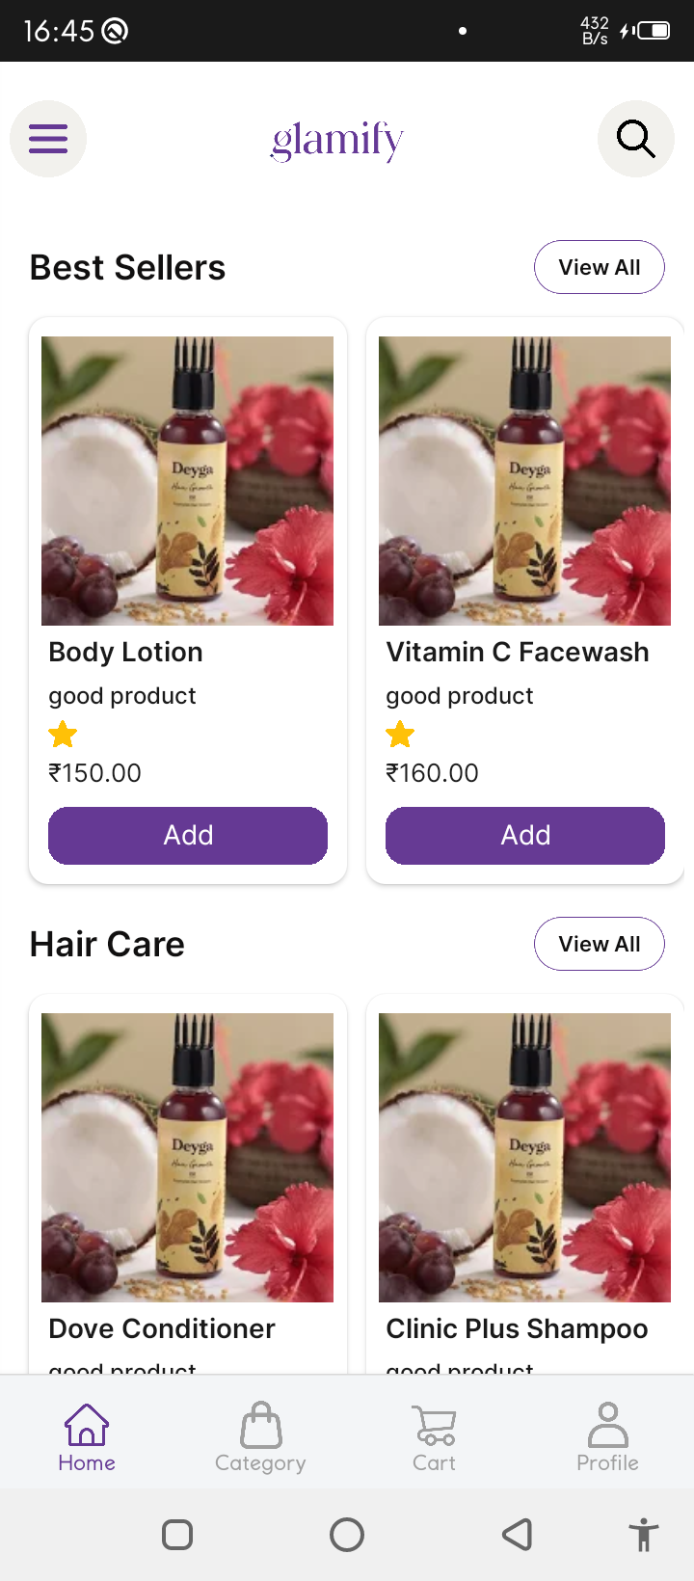
UI

Slide 31
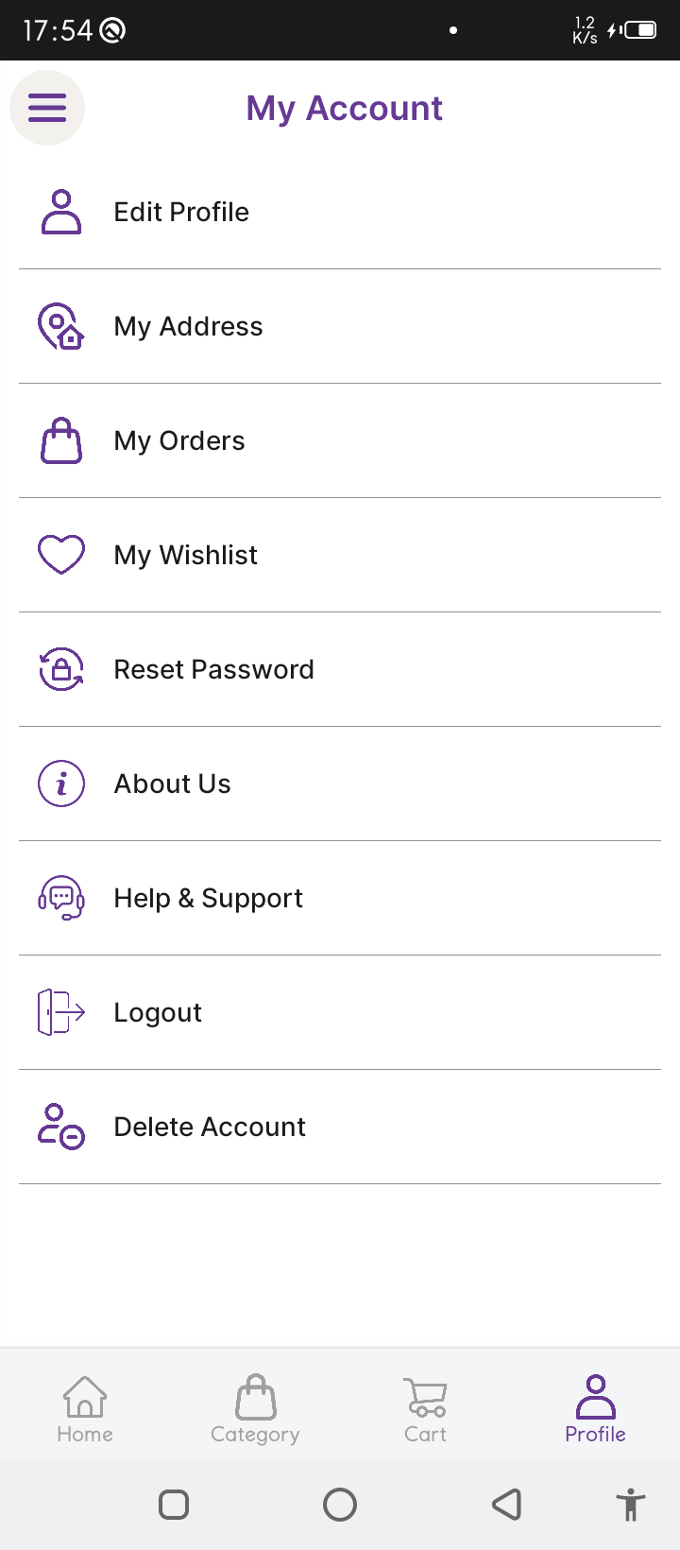
UI

Slide 32
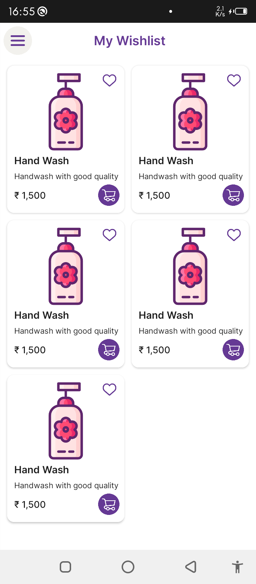
UI

Slide 33
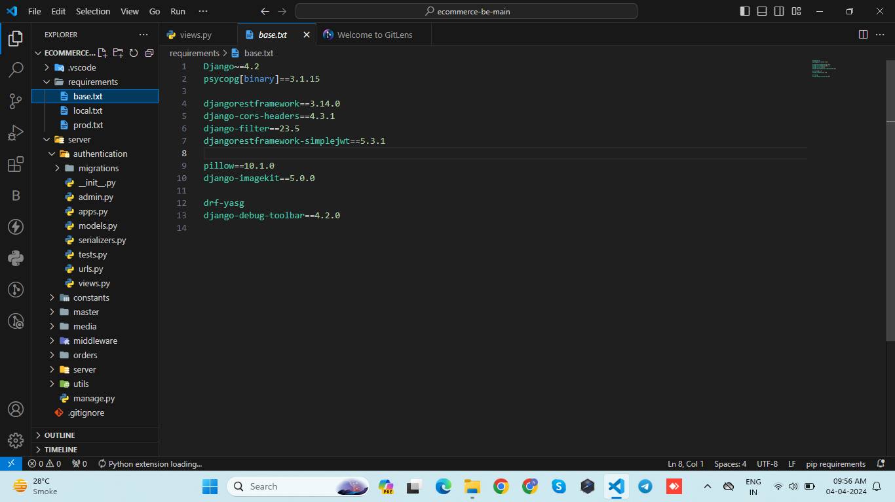
Requirements Of code

Slide 34
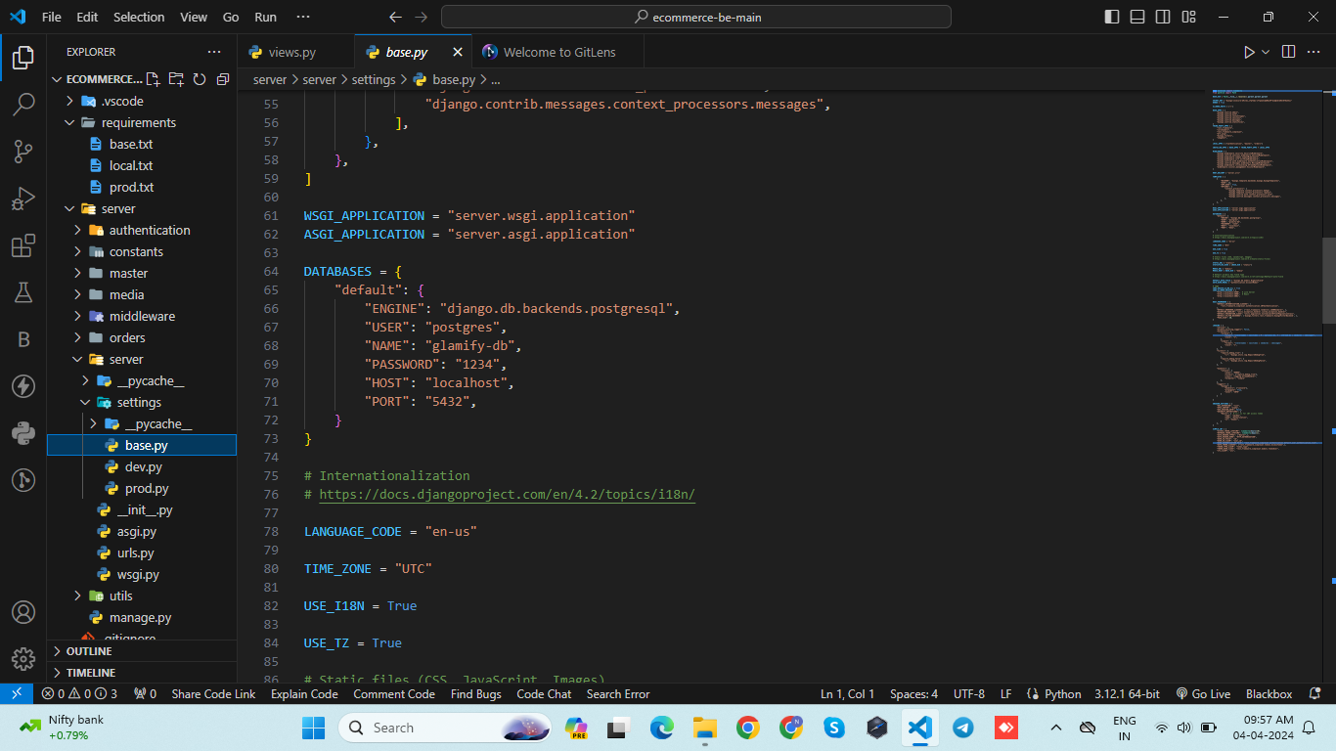
Database

Slide 35
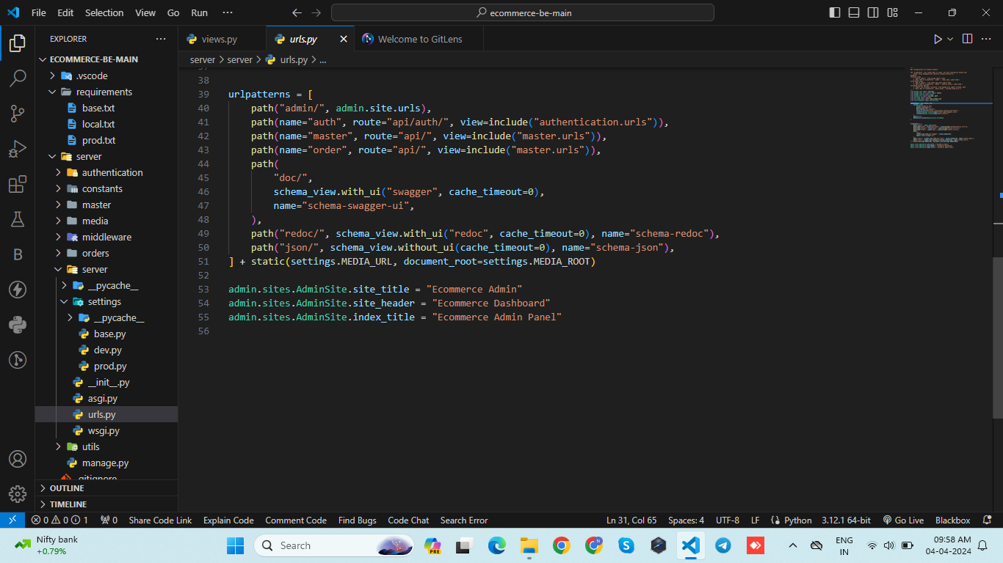
Main URLS

Slide 36
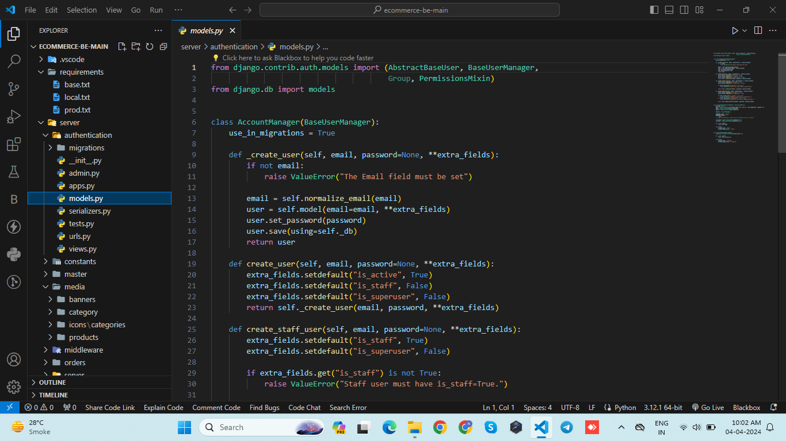
Authentication App Model

Slide 37
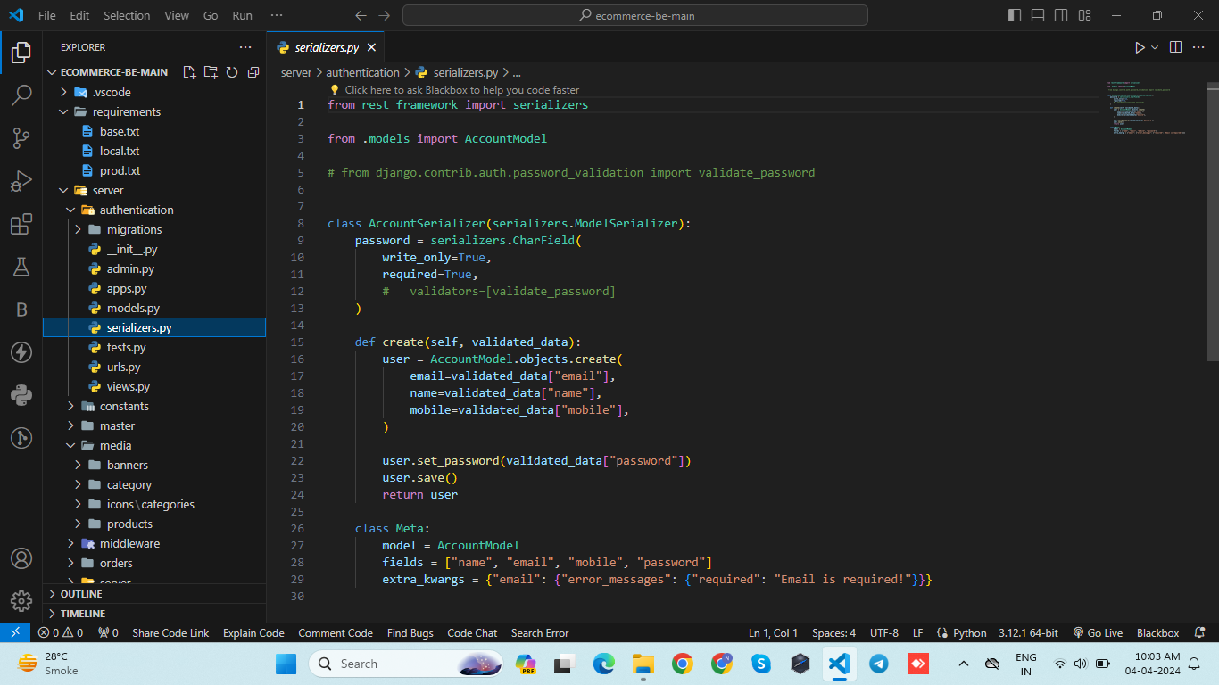
Authentication API

Slide 38
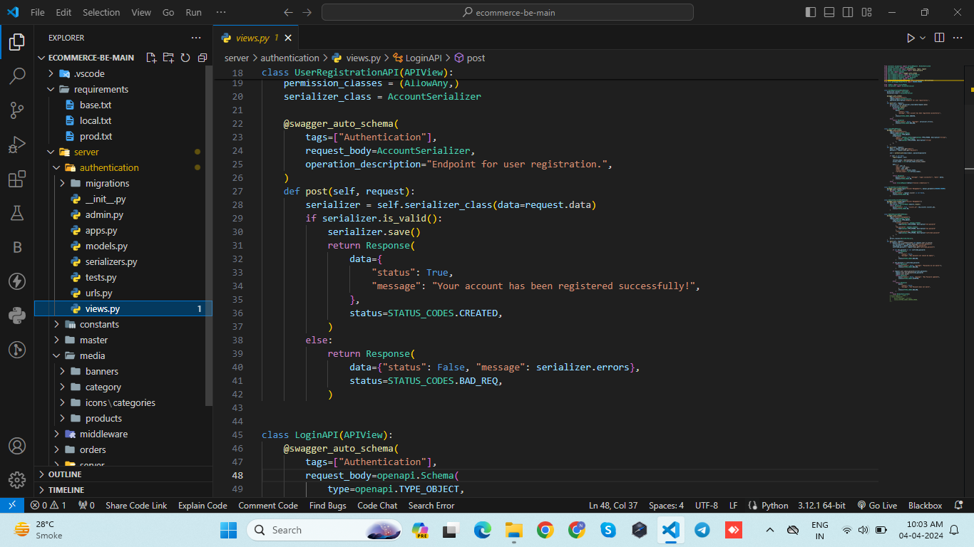
Authentication App Views

Slide 39
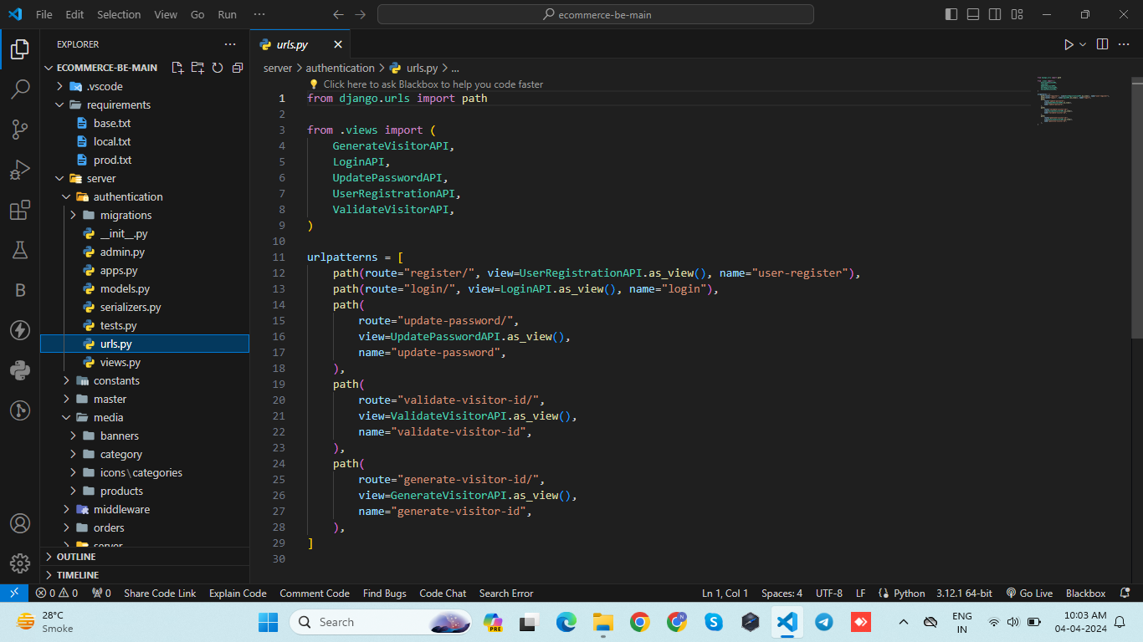
Authentication App URLS

Slide 40
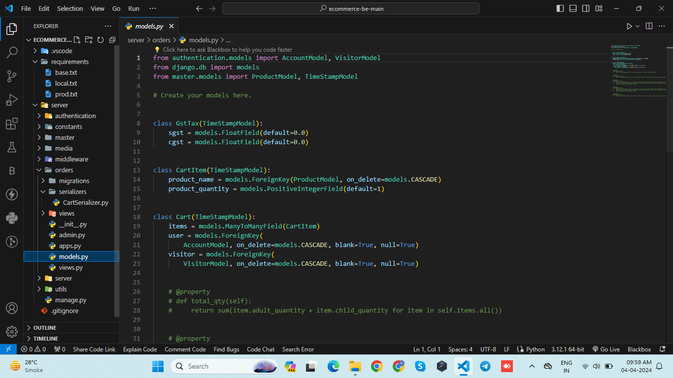
Models for Order App

Slide 41
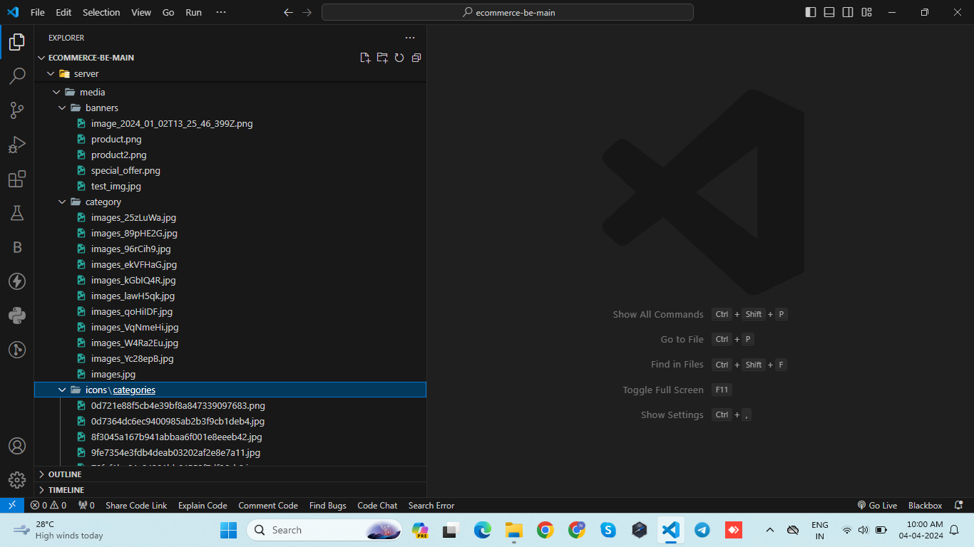
Add All Media

Slide 42
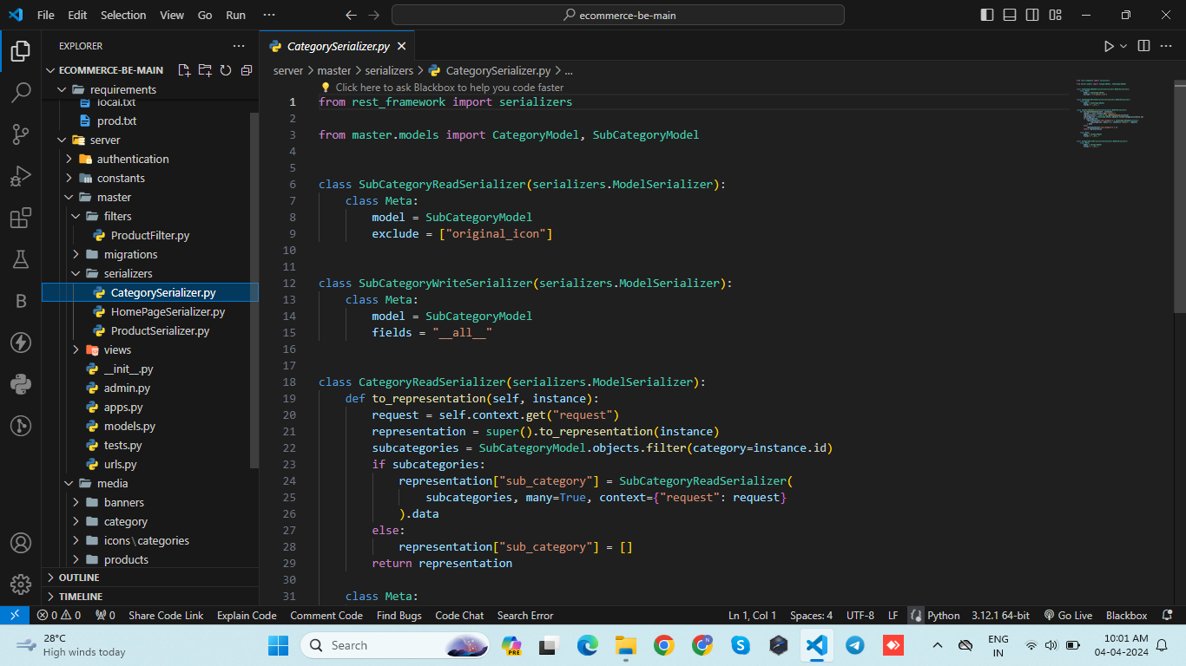
API in master App

Slide 43
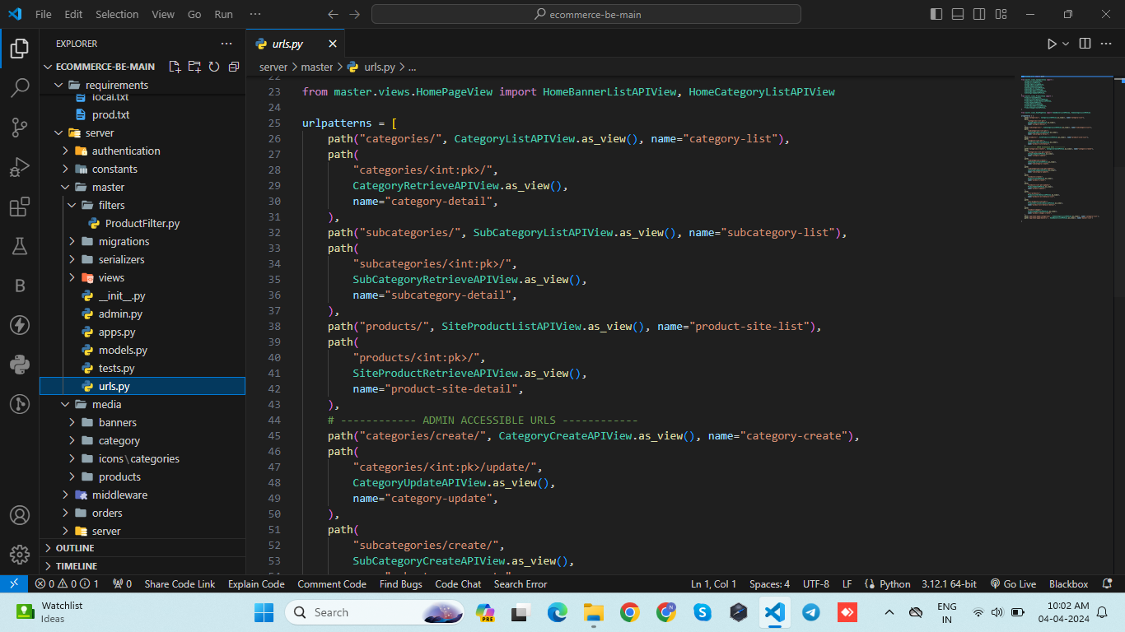
Master App Urls

Slide 44
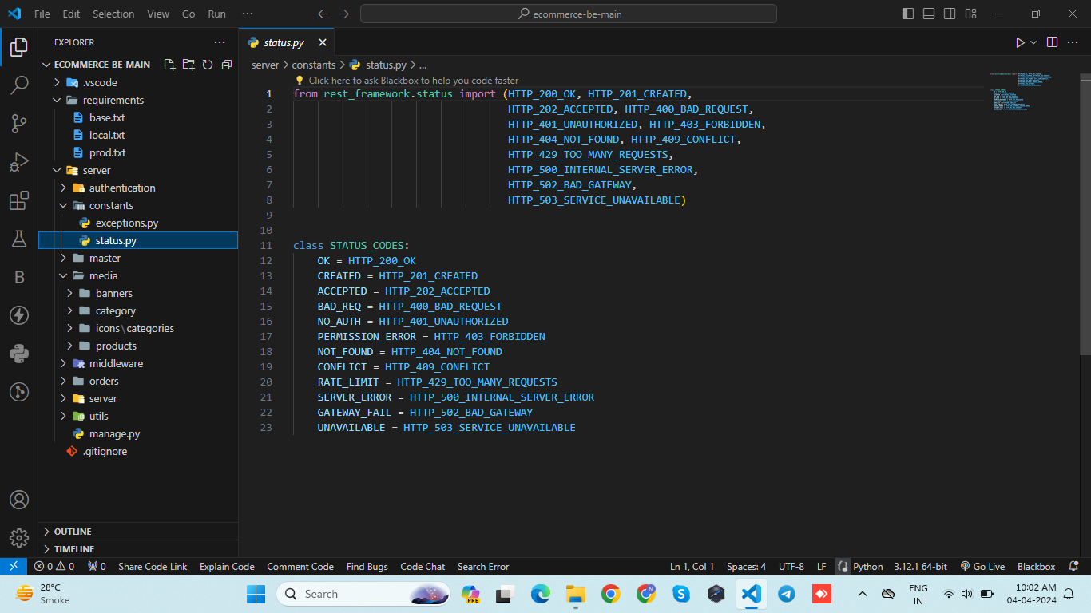
Constants Files Code

Slide 45
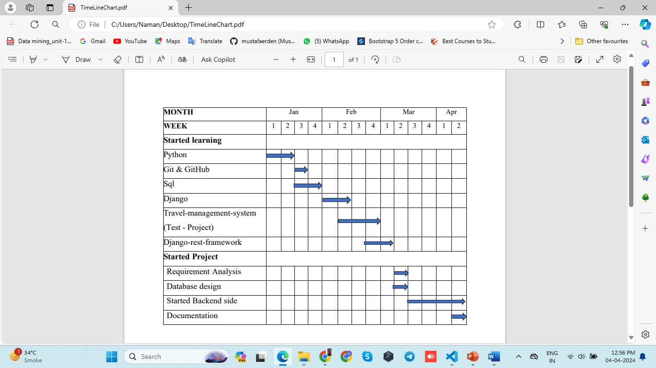
WorkTimeLine Chart

Slide 46
THANK YOU

